Slide 1
Analysing the best location for a new restaurant in New-York City
Applied Data Science Capstone
IBM Data Science Professional Certificate
March 2019
Ahmed mohy

Slide 2
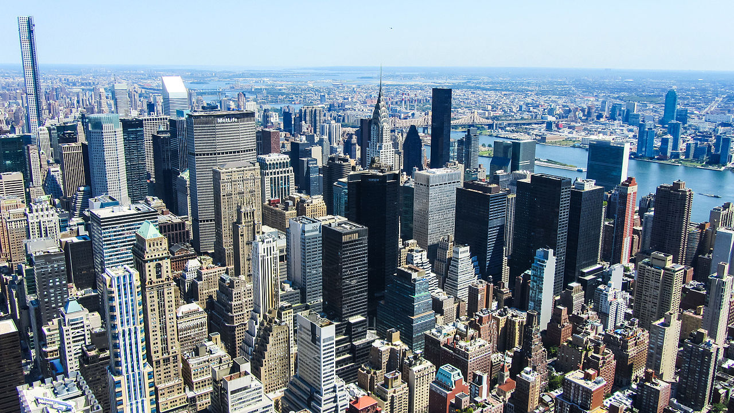
Analysing the best location for a new restaurant in New-York City

Slide 3
Synopsis
Part 1: Introduction
The restaurant industry is difficult to succeed in. Aside from the operational challenges, there are two external factors that are required to survive:
1) Regular foot traffic
2) An underserved population that they can address.
Foot traffic may come from locals and tourists visiting other nearby venues, from the people that live in that neighbourhood, or in some cases: a busy work centre/industrial area.
A well-organized restaurateur will know their particular cuisine style, price range, and desired target customers. A target customer in this case can be defined as underserved if there’s a lack of other options that serve this restaurant’s style, price, and theme (i.e., an Italian restaurant in little Italy will have a hard time differentiating itself)

Slide 4
Synopsis
Part 2: Business Explanation
The restaurant in mind for this study is a new Hong Kong style cafe, modeled after one of my favourite restaurants in Boston: Double Chin
This restaurant caters to a younger crowd, mostly in their 20’s and 30’s. Their menu serves fast, cheap, and delicious eats with an emphasis on regularly creating fun dishes.
Their late-night menu begs for them to be the last stop after a long night on the town. The target customer is groups looking for something to eat in between visiting art shows, concerts, bars, and other big social events.

Slide 5
Synopsis
Part 3: Business Problem
The issue here is that we don’t know where the restaurant should be located. The owners had success with their first restaurant in Chinatown, but the crowding of other places serving similar fare made it extremely difficult to stand out.
Aside from Chinatown, the owners don’t know where else to look. They need a neighbourhood with a steady stream of customers visiting other nightlife options, with hopefully not too many other Chinese/Asian fusion restaurants in the area.
Can we use publicly available data to source potential new locations for their restaurant?

Slide 6
Data
To attempt a solution at this problem, we’ll be using the Foursquare API to fetch venue information and analyse different neighbourhoods.
To fulfil the requirements of the business problem stated, we’ll specifically be looking for two types of information:
1- Data on the neighbourhoods in general, specifically:
- The categories for each venue in each Manhattan neighbourhood
- Popular days and hours for venues that serve our target customer (nightlife venues)
- A popularity score for each of the target venues, calculated by:
- The total number of tips
- The like/dislike volume and ratio
2- Data on venues that might compete with ours, specifically:
- The relative frequency of all late night restaurants
- The price range of late night restaurants in each neighbourhood
- The cuisine type of late night restaurants in each neighbourhood

Slide 7
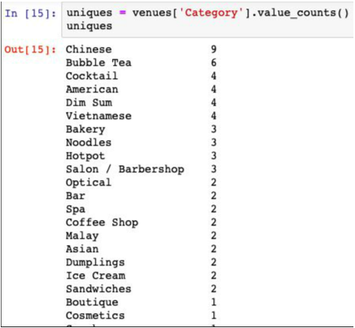
Data
Part 1: Data (fetching popular venues in a neighbourhood)

Slide 8
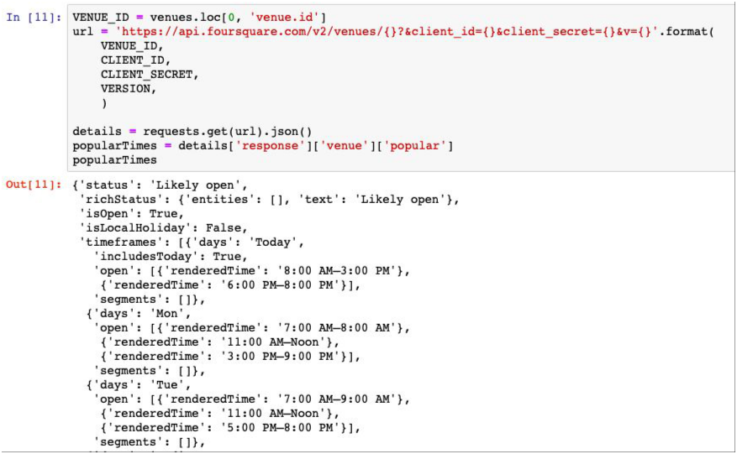
Data
Part 2: Data (Fetching the popular hours for a venue)
.

Slide 9
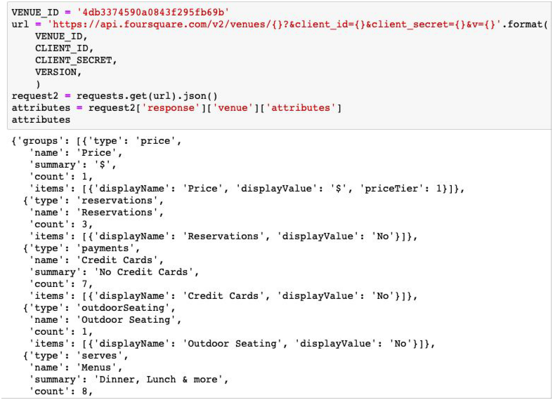
Data
Part 3: Data (Fetching venue attributes)

Slide 10
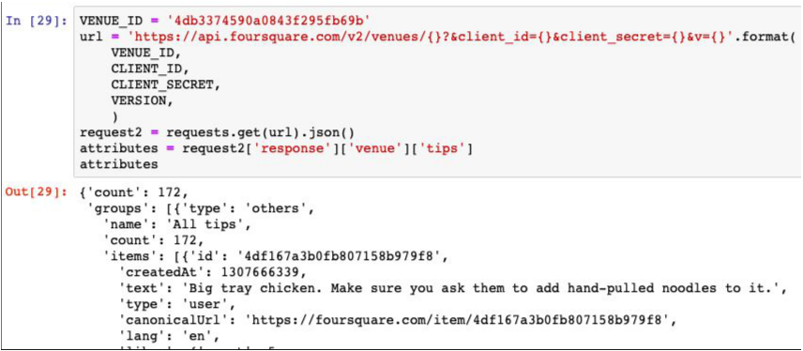
Data
Part 4:Data (fetching number of tips)

Slide 11
Methodology
After fetching data for all venues and neighbourhoods in Brooklyn, I filtered out the specific venues I was interested in (Restaurants and Nightlife venues). I then picked venues from this list that had a high number of likes and tips (showing high popularity). This list was used to narrow down the neighbourhood list to just 19 entries
I took the filtered list, and searched for venues again, this time with a little wider search radius and a higher limit on the # of venues
I took the information from this list of “hot” neighbourhoods and pulled together a relative frequency of nightlife venues, restaurants, and then Chinese Restaurants

Slide 12
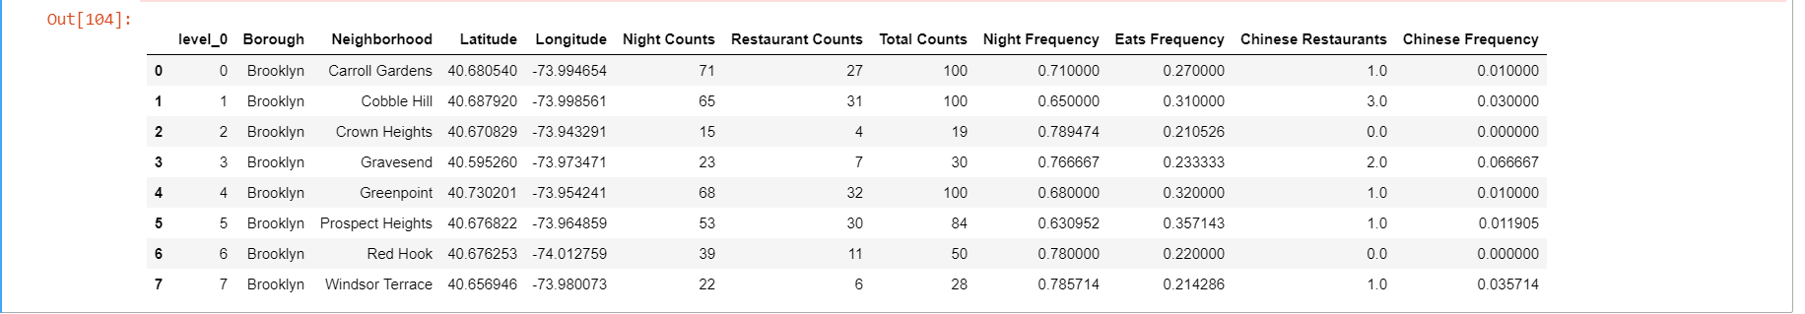
Methodology

Slide 13
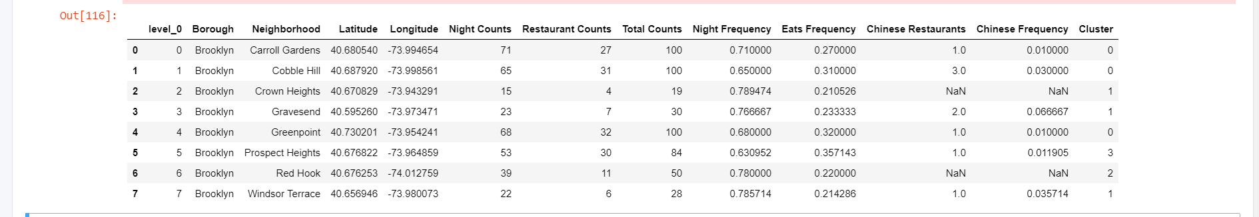
Methodology
After pulling all the data together in a single data frame, I ran a clustering analysis to group similar neighborhoods together
The different clusters were analysed to see which were most favourable for our new restaurant (a lot of nightlife, very few Chinese restaurants)

Slide 14
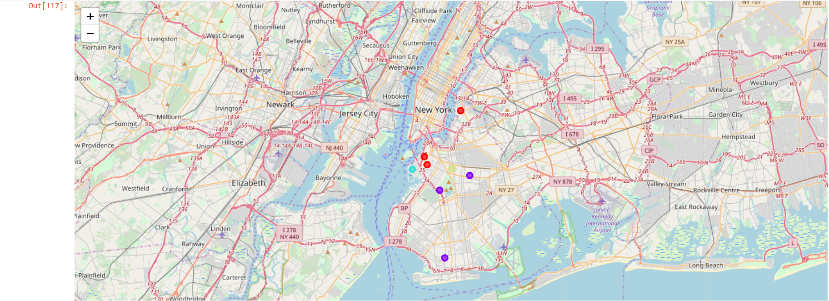
Results:
The cluster shown in Sky blue are the most ideal spots for our new concept restaurant

Slide 15
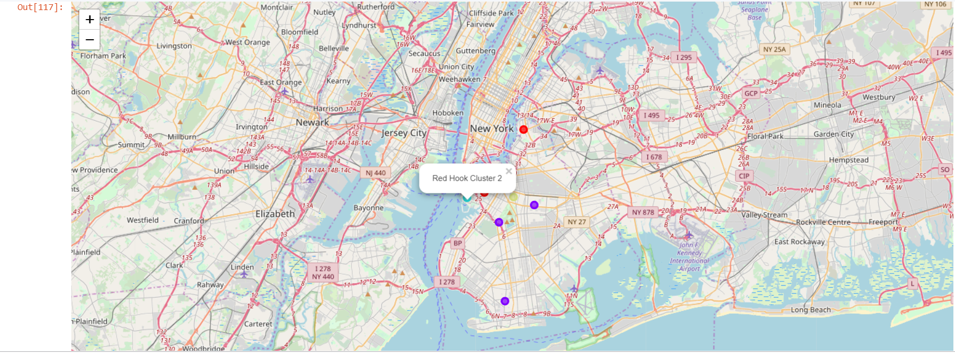
Results This is based on the high number of nightlife venues and the almost complete absence of other Chinese Restaurants.

Slide 16
Discussion
Basing our popularity decision based on number of likes and tips is biased, since it doesn’t take into account the length of time a place has been open in, When you use the explore endpoint in the Foursquare API it returns search results based on your own user preferences. Obviously this doesn’t give perfectly fair data to inform our model
Conclusion:
After picking the best neighbourhood, there’s a lot more work that needs to be done to actually find the best location. However, this project gives a nice start to the process and narrowed down a very long list (from 70 to 3 choices) which are:
Red Hook
Crown Heights
Prospect Heights
Windsor Terrace

Slide 17


